Slide 1


Well-being Benefits
Wellfocused Employee Well-being Program
Community Connections
Giving Back
EAP and Other Mental Well-being Services
LIVE YOUR LEGACY
Notes:
Penn Medicine Lancaster General Health is committed to providing support for your physical, mental and financial well-being. For your physical and mental health, In addition to our core benefit options, you’re encouraged to take advantage of free and discounted facilities and services and a wealth of online information, plus earn financial rewards.

Slide 2


Wellfocused – Care Navigation
Connecting you to the benefits you need
717-544-3546
Wellfocused-lgh@pennmedicine.upenn.edu
Notes:
Let’s begin with the optional Wellfocused Employee Well-Being program. It’s available to all employees on day one. .
The Wellfocused can help you navigate your total rewards, so you can take advantage of the benefits that are right for you at your specific life stage and important moments. To speak to a member of the team, call or email them.

Slide 3

Wellfocused – Health Screenings
Free onsite screenings
Identify health risks
Earn financial rewards for completing
Notes:
Wellfocused provides free onsite annual health screenings, available twice per program year. You also can receive a screening from your own provider. Screening results can help you identify health risks so that you can take action before they become more significant health problems.
In addition, you can earn financial rewards when you complete your screening.

Slide 4
Wellfocused Rewards – Financial Rewards
Well-being assessment
Health screenings
Preventive care and annual checkups
Meeting healthy goals
Self-directed learning opportunities and activities
Personal and team challenges
Holistic therapy services and financial counseling
Tracking movement and exercise
Connecting with meQuilibrium to build resilience and improve mental health
lgh.limeade.com
Notes:
The Wellfocused Rewards program gives you a financial incentive to complete your health screening and a variety of other well-being activities throughout the year.
The program has levels of rewards that can add up to $400 cash in your paycheck, during the year.
If you haven’t yet connected with the program, download the Limeade app today. That’s where you’ll track your screenings and other activities.
Please note that, according to the IRS, your rewards will be considered taxable income.

Slide 5
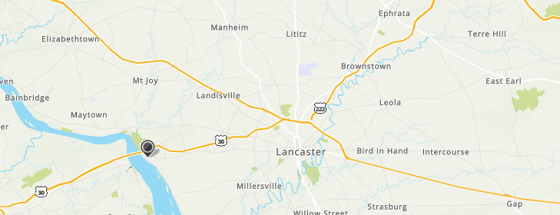
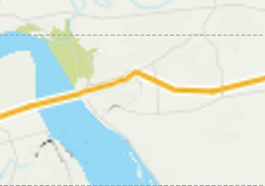
Wellfocused – Free Onsite Fitness Centers
Mill Building
26 N. Cedar Street, Lititz
Open 4:30 a.m. to midnight
Commercial Avenue Building
1097 Commercial Avenue, East Petersburg
Open 4:30 a.m. to midnight
Downtown Pavilion
540 Duke Street
Open 24/7
Notes:
If you’d like to work out at a gym or take fitness classes, be sure to check out the fitness centers at the Downtown Pavilion, Commercial Avenue and Mills buildings.
You can use the equipment and free weights any time, plus register for classes at no charge!
See StarNet for a link to register for access to the centers and sign up for fitness classes.

Slide 6

Free Coaching Support
1-on-1 or group health coaching
Sample popular topics:
Exercise and Movement
Health Conditions (cholesterol, diabetes, blood pressure)
Nutrition/Weight Management
Social Relationships
Stress Management
717-544-3546
Wellfocused-lgh@pennmedicine.upenn.edu
Notes:
Could you benefit from some free, one-on-one support to improve your health?
Wellfocused offers coaching for a variety of health and wellness concerns, including nutrition and weight loss and many popular topics.
To connect with these services, visit StarNet or contact the Wellfocused team.

Slide 7

Employee Assistance Program
Care manager available 24/7
Up to 8 free counseling sessions
Legal and financial services
Eldercare information and support
Education and referral services
800-364-6352
Onsite Resilience Coach
717-979-6766 or steven.fetrow-keihl@pennmedicine.upenn.edu
Notes:
The Employee Assistance Program, or EAP by Quest, offers you and your family eight free, confidential counseling sessions per benefit plan year. You can use their education tools and referral services to help manage emotional, behavioral and mental health concerns, as well as child and elder care, legal and financial challenges.
We also have a resilience coach available onsite, at no charge, a few times a week. Simply call or email for a confidential appointment.

Slide 8

Online Psychiatry Services
Discounted rates
Children and adolescents
Geriatric patients
Addiction issues
Take a free assessment to begin
Receive a match that meets your needs and schedule
833-351-8255
hello@talkiatry.com
Notes:
And, if you’re looking for a longer-term relationship with a psychiatrist, you can connect with one online through Talkiatry, at discounted rates. They see patients ages 5 and older, offering services for children and adolescents, geriatric patients, addiction issues and more. What’s more, they can typically see patients within 5 days or less.

Slide 9

Penn Medicine Mental Health Platform
Individualized articles, videos, podcasts and self-led training
Live one-on-one sessions with peers, coping first aid coaches, therapists, psychiatrists, others
Registered dietitians, strength and conditioning coaches, group sessions
penncobalt.com
Notes:
PennCOBALT, Penn Medicine’s mental health platform, is another confidential resource that can help you find the right coping support for your mental and emotional well-being.
Visit penncobalt.com to find a wealth of free and discounted resources such as therapy, a medication prescriber, group sessions, wellness coaching, spiritual support and help in a crisis.

Slide 10

Caregiving Support – Free
Aging parents
Veterans
Special needs
Mental health
Child and teen support
Financial support
Join.wellthy.om/uphs
Notes:
Your work doesn’t stop when you get home. You may be dealing with caregiving responsibilities there, too.
Whether you’re caring for yourself, an aging family member or a teen going through a difficult time, your free membership to Wellthy can help. It matches you with a care team that can provide personalized support for tackling the logistical and administrative tasks of caring, like finding providers and navigating benefits. It also provides a social space where you can find support, share your experiences and exchange knowledge with other caregivers. Get started by visiting join.wealthy.com/uphs.

Slide 11
Community Connections
Directory by County
Mental health
Domestic violence
Food and clothing resources
Housing resources
Parenting support
Employee Resource Center
Up to $2,000
Temporary hardship
Career Closet
Food Pantry
Employee Assistance Fund
findhelp.org
lghealthbenefits.com
Notes:
You or your colleagues may face other challenges outside of work, as well. We’ve assembled information and resources to help you, through Community Connections.
On lghealthbenefits.com, select Your Community Connections on the Resources tab. You’ll find a directory of resources that will help you connect with free, confidential community support systems in your county. Organizations included in the directory help address mental health, domestic violence, food, clothing and housing resources, parenting support and more. You’ll also find information about downloading the findhelp.org app.
In addition, our onsite Employee Resource Center includes our own Career Closet and Employee Food Pantry.
And employees facing hardships such as injury or illness, destruction of their home or death of an immediate family member can apply to the Employee Assistance Fund. You’ll find an application at lghealthbenefits.com.

Slide 12

Giving Back
Spirit of Giving
Employee Assistance Fund
LG Health Foundation
Employee Volunteerism Policy
Lancastergeneralhealth.org/ giving-foundation
Notes:
Giving back to your community is an important part of your mental and emotional well-being, too. LG Health can help you, help others.
During the winter holiday season, we adopt families in the community who need support through the Spirit of Giving. You can contribute by purchasing items online through registry links, shopping retail and eating at participating restaurants. Look for more information on specific needs and ways to give during Christmas in July.
You also can contribute to the Employee Assistance Fund for your fellow employees by connecting with the LG Health Foundation.
If you would like to support patient-facing services, you can contribute to the Lancaster General Health organization through the LG Health Foundation. Contributions have helped create patient assistance funds, establish nursing scholarships, make new facilities possible, acquire advanced technology, and develop innovative care models to support our most vulnerable patients.
And we actively promote employee volunteer opportunities – we know giving has mutual rewards.

Slide 13
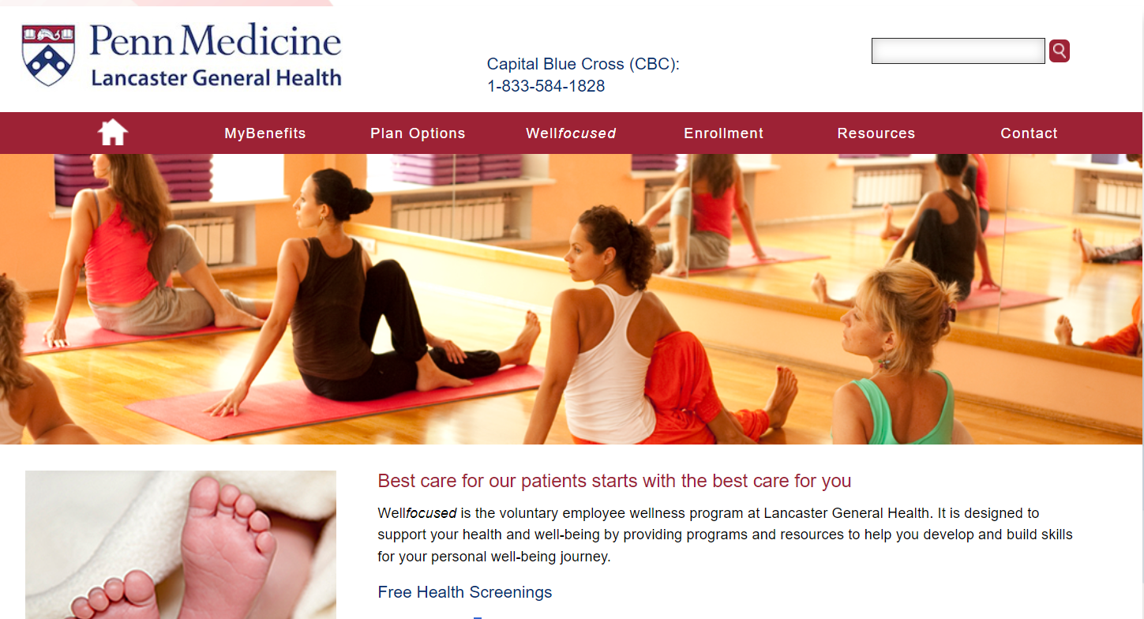
Learn More
lghealthbenefits.com
LGH-benefits@pennmedicine.upenn.edu
Questions? Call 717-544-4915
Notes:
Your overall well-being is important to you AND to LG Health. We hope you’ve enjoyed learning more about all your options for services and support and will try out some of them soon. For more information, including plan documents, visit lghealthbenefits.com. You also can email or call the LGH benefits team for help.

